Slide 1
Contextualization & Design Check-In
Derek Brandt - Israel Sanchez Tellez
Tyler Orman - Aryan Rao
Team ID: sddec24-03
Client: DigiClips
Faculty Advisor: Dr. Ashfaq Khokhar

Slide 2
Agenda
Project Overview
Artifacts
Human
Economic
Technical

Slide 3
Project Overview

Slide 4
Project Overview
DigiClips is striving to be a website that catalogs diverse media content
including news coverage, advertisements, radio broadcasts, and podcasts.
Our team’s primary objective centers on revitalizing
the administration portal which oversees
users and server status.

Slide 5
Artifacts

Slide 6
Journey Map
Bob gets a call saying they just landed a new client for the search engine.
The new client sends him a message saying his account isn’t working for the search engine.
Bob uses the administrative portal to see that the search engine server is down.
Bob is able to contact the backend techs to tell them to get the server started again.
The client tells bob that he is able to use his account again.

Slide 7
Market Analysis - Pro/Cons
 | Pro | Con
Tableau | Updated and supported by the company Highly scalable and can handle large datasets and complex analytics Users can create interactive dashboards that enables stakeholders to explore data and gain real-time insights from it. | there is a licensing fee in order to use it Because it is super customizable, it takes a lot of overhead to learn how to use it
ISEAGE | Integrates with internal servers Provides a way to contact clients directly through the page | No way to edit data Can be difficult for new users to understand
Airplane | Customizability for user needs It can provide users with templates for simple design | Not all database platforms are supported Only basic designs available Professional options are paid services

Slide 8
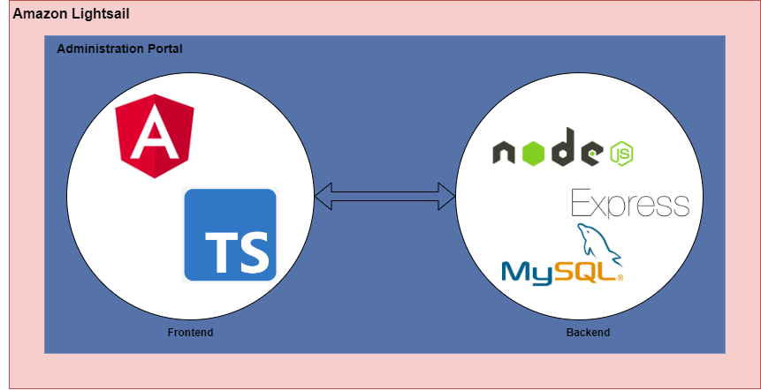
Technical Complexity Analysis

Slide 9
Technical Complexity Analysis
Internal Complexity
Frontend uses Angular framework with Typescript.
Backend component uses Node.js, Express framework and MySql database.
External Complexity
Client's goal: Hosting app on cloud via Amazon Lightsail.
Team members have experienced with Angular, Express, and MySql but lack experience with Lightsail

Slide 10
Human

Slide 11
Human
Our solution uses a series of dashboards tailored to each of our user groups, allowing us to effectively address our user needs. To account for changing needs in the future, we could implement our system in a modular fashion that allows the users to choose which items they see as opposed to those items being tied to a user role.

Slide 12
Economic

Slide 13
Economic
Existing solutions are either…
Client Specific (I.e. only works for Iowa State)
Contain learning curves
Miss necessary features
Our solutions will be able to…
Monitor Digiclip specific machines
Be minimally invasive with information
Controlled by a super administrator
Free to client
Our solution needs improvement…
On customizability
Maintainability

Slide 14
Technical

Slide 15
Technical
Our group of comprised…
3 Software Engineers
1 Cyber Security Engineer
The internal complexity is comprise of…
Backend Server written in JavaScript
Frontend Server written in Angular
SQL server
Artistic Design
Functional UI/UX Design
Needs complexity in..
Software architectural choices
Cyber Security safety
Technology research

Slide 16
Questions?

